Slide 1
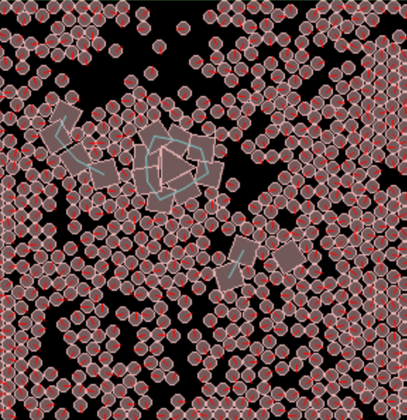
Artificial Life as Controlled Disequilibrium
Dr Steve Battle UWE Bristol
AISB Convention 2023
Philosophy & AI (AIP)

Slide 2
What is Life? ask ChatGPT
“Life is a complex and diverse phenomenon that is typically characterized by several key attributes. In general, life refers to the state or quality of being alive, which is exhibited by living organisms. While there is no universally accepted definition of life, common characteristics of life include:
Cellular organization: Living organisms are composed of cells, which are the basic structural and functional units of life. Cells can be either single-celled (unicellular) or multicellular, and they are capable of performing various physiological functions.
Metabolism: Life requires energy, and living organisms typically engage in metabolic processes to obtain, use, and store energy. These processes include respiration, digestion, and photosynthesis, among others.
Homeostasis: Living organisms have the ability to maintain stable internal conditions despite changes in the external environment. This is known as homeostasis and is essential for the proper functioning of cells and organs.
Growth and development: Living organisms can grow in size and complexity over time, and they can undergo development and maturation from birth to adulthood. This process often involves changes in form, structure, and function.
Reproduction: Living organisms are capable of reproducing, either sexually or asexually, to produce offspring that inherit genetic traits from their parents. Reproduction is a fundamental characteristic of life that allows for the continuation of species.
Response to stimuli: Living organisms are capable of sensing and responding to their environment through various mechanisms, such as movement, sensory perception, and behavioral responses.
Evolution: Living organisms are subject to the process of evolution, which involves changes in genetic traits over successive generations. Evolution is a driving force behind the diversity and complexity of life on Earth.”

Slide 3
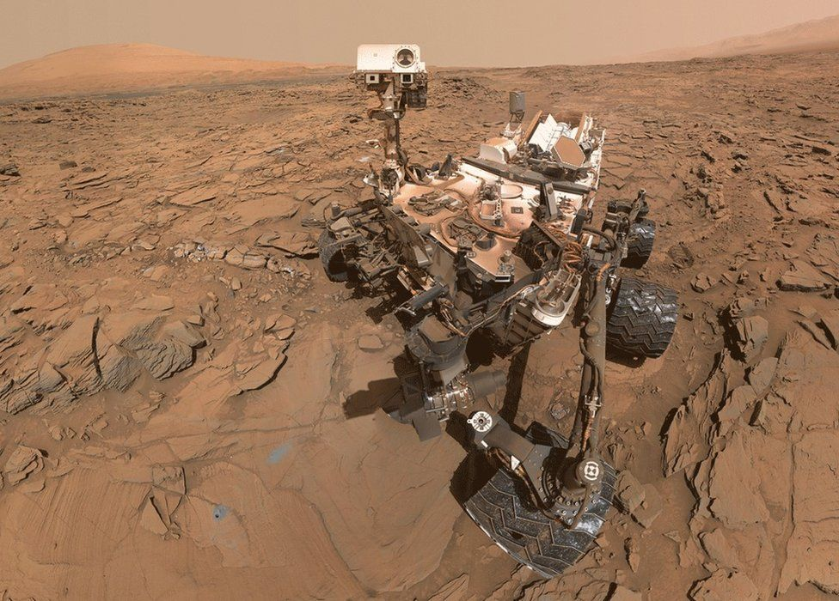
Curiosity
A planet bearing life is distinguishable from a sterile one by:
The omnipresence of intense orderliness and of structures and of events utterly improbable on a basis of thermodynamic equilibrium.
Extreme departures from an inorganic steady-state equilibrium of chemical potential.
James Lovelock
Curiosity finds the amount of oxygen on Mars rises 30% in spring & summer.

Slide 4
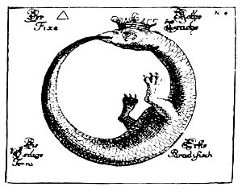
Autopoiesis
From Greek:
“auto” (self)
“poiesis” (creation)
Autopoiesis is synonymous with life.
Artificial life as simulated autopoiesis

Slide 5
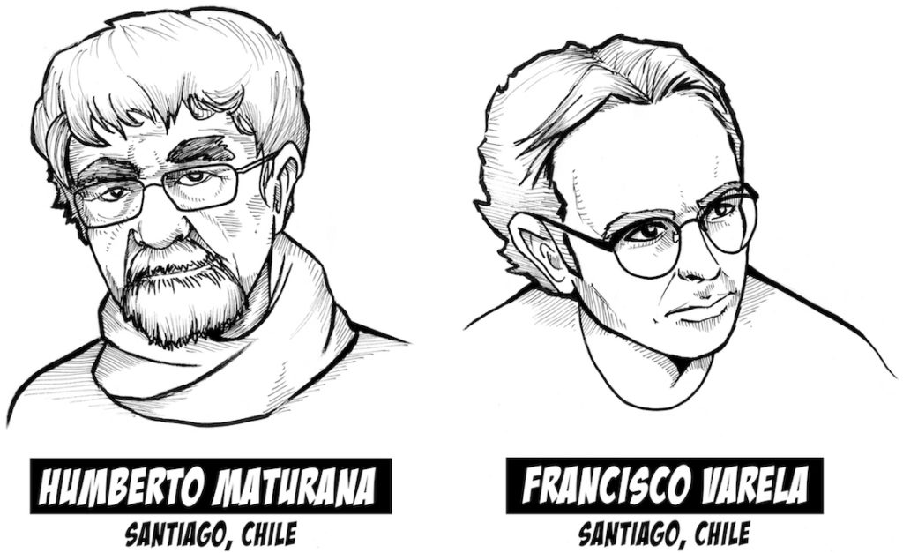
Living Machines
Life = Organisational Closure
+ Structural closure
“A universe comes into being when a space is severed into two. A unity is defined.”
Autopoiesis and Cognition: The Realization of the Living (1972)

Slide 6
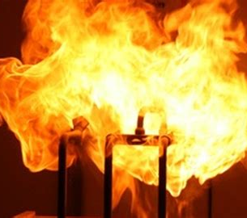
Organisational Closure
A network of processes of self-production of components.
examples:
chemical reactions
fire
nuclear explosion
Covid virus
Krebs cycle

Slide 7
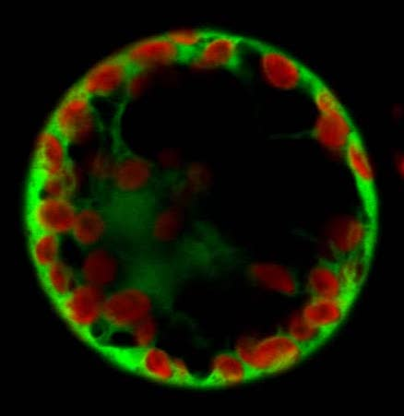
Structural Closure
The emergence of a boundary dividing self from non-self.
examples
cell wall
crystals
soap bubble
corral

Slide 8
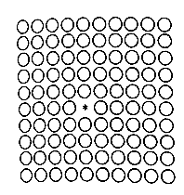
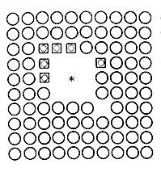
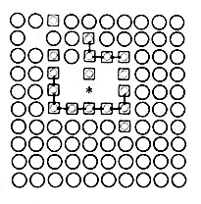
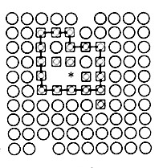
Varela’s Cellular Automaton*
1) Catalyst in a sea of substrate
2) Substrate fused into links
3) Bonds form
4) Boundary defines a unity
*Principles of Biological Autonomy (1979)

Slide 9
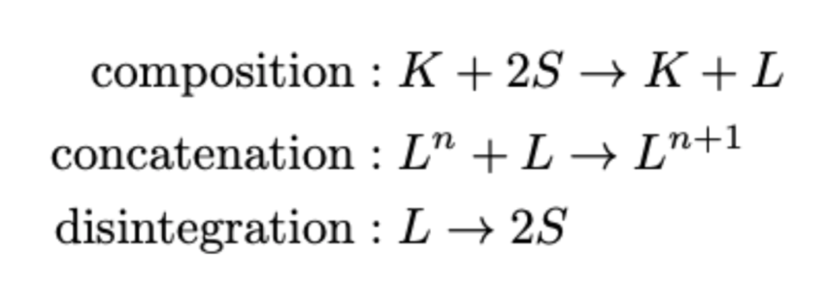
Reaction rules
Where:
S is the substrate (circles)
K is a catalyst (star)
L are links (squares)
Concatenated links (bonds) are shown as lines.

Slide 10
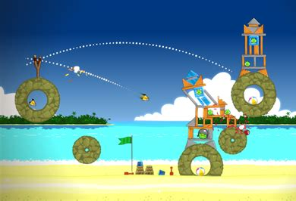
Liquid Automata
Take a game physics engine – the one from “Angry Birds”
Continuous space/time
Add chemistry…

Slide 11
Artificial Chemistry
+
+
→
+
composition
+
→
concatenation
→
+
disintegration
Organisation closure

Slide 12
Artificial Autopoiesis
Particles move freely in 2D space.
Bathed in substrate (circles).
Energy input as Brownian motion.
‘Chemical’ reactions on collision.
Closed boundary forms, enclosing catalyst (triangle).
‘Cell wall’ throttles back production of link particles (squares).

Slide 13
Baseline ‘chemical’ equilibrium
Knock out rule that concatenates links to form a boundary.
Larger ‘compounds’ cannot form.
Mean number of link particles produced is greater than the original.
Life is out of equilibrium relative to this ‘chemical’ baseline.

Slide 14
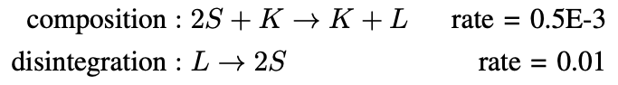
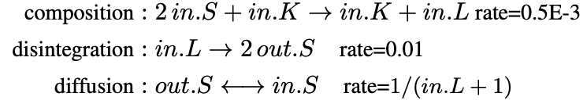
We’re going to need a simpler model
Model A: Baseline
Model B: Compartmentalised
Rate of diffusion is inversely proportional to concentration of interior link particles.
in.K
in.S
in.L
out.S
out.L

Slide 15
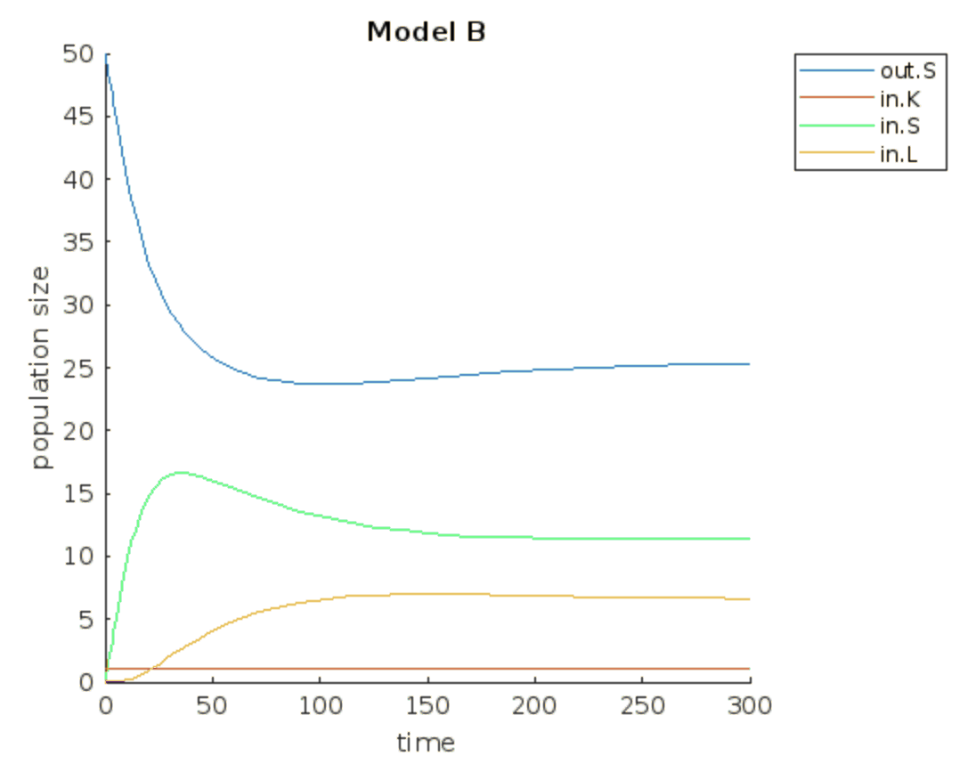
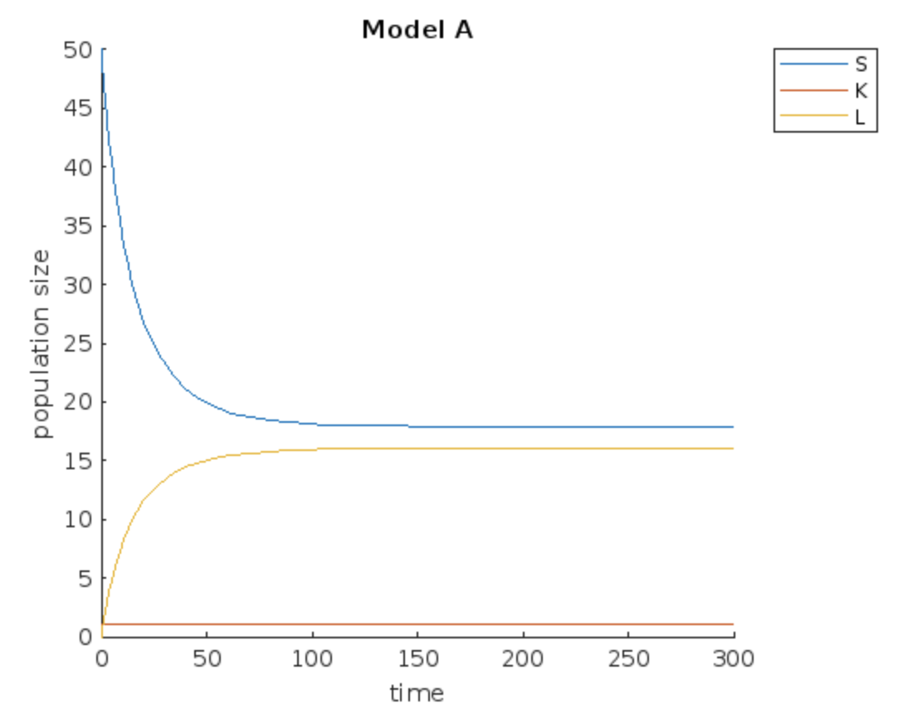
MathWorks SimBiology
Model A: Baseline
Model B: Compartmentalised

Slide 16
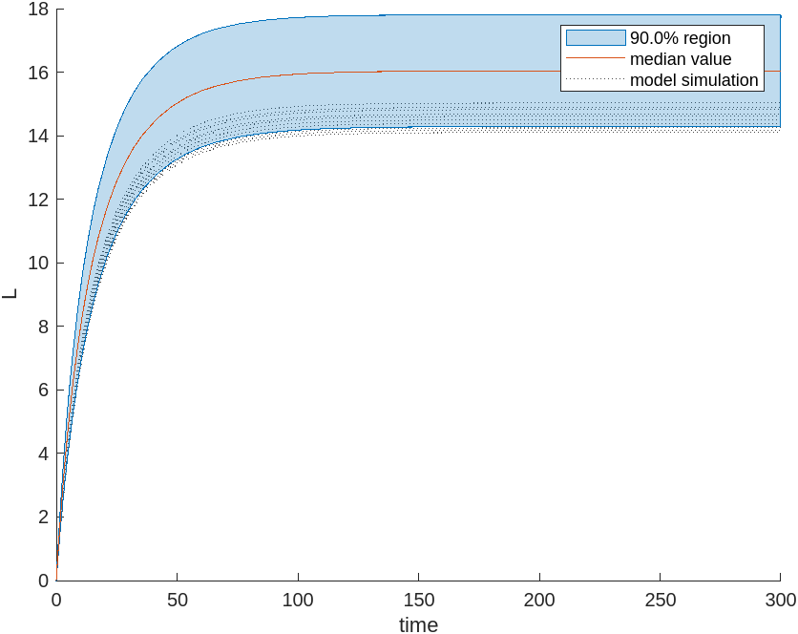
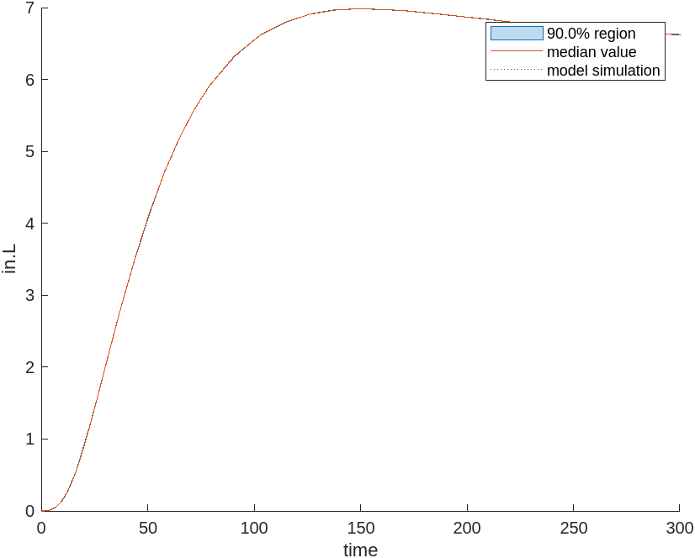
Sensitivity
Model A: Baseline
Model B: Compartmentalised
‘Chemical’ model sensitive to initial concentration of substrate.
Equilibrium is uncontrolled.
Artificial life not sensitive to initial concentration of substrate.
Disequilibrium is controlled.

Slide 17
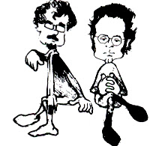
Conclusion and Questions
Mars and beyond…
“Autopoiesis in the physical space must be viewed as defining living systems anywhere in the universe, however different they may otherwise be from terrestrial ones.”
Autopoiesis and Cognition: The Realization of the Living (1972)
Maturana and Varela

